Slide 1
User Registration and Login System using JWT (JSON Web Token) in Python (Flask framework)

Slide 2
Step 1: Install Dependencies
Open your terminal and install these packages:
pip install Flask flask-bcrypt Flask-JWT-Extended
Step 2: Project Structure
jwt_auth_app/│
├── app.py
└── users.db (auto-created later)

Slide 3
Step 3: Import Required Libraries
from flask import Flask, request, jsonify
from flask_bcrypt import Bcrypt
from flask_jwt_extended import ( JWTManager, create_access_token, jwt_required, get_jwt_identity)
import sqlite3

Slide 4
Step 4: Initialize Flask App and JWT
app = Flask(__name__)
app.config['JWT_SECRET_KEY'] = 'your_secret_key_here'
# change this to a strong key
bcrypt = Bcrypt(app)
jwt = JWTManager(app)

Slide 5
Step 5: Database Setup (SQLite for simplicity)
def init_db():
conn = sqlite3.connect('users.db')
c = conn.cursor()
c.execute('''
CREATE TABLE IF NOT EXISTS users (
id INTEGER PRIMARY KEY AUTOINCREMENT,
username TEXT UNIQUE NOT NULL,
password TEXT NOT NULL
)
''')
conn.commit()
conn.close()
init_db()

Slide 6
Step 6: User Registration Endpoint
@app.route('/register', methods=['POST'])
def register():
data = request.get_json()
username = data.get('username')
password = data.get('password')
if not username or not password:
return jsonify({"error": "Username and password are required"}), 400
hashed_pw = bcrypt.generate_password_hash(password).decode('utf-8')
try:
conn = sqlite3.connect('users.db')
c = conn.cursor()
c.execute('INSERT INTO users (username, password) VALUES (?, ?)', (username, hashed_pw))
conn.commit()
conn.close()
return jsonify({"message": "User registered successfully"}), 201
except sqlite3.IntegrityError:
return jsonify({"error": "Username already exists"}), 409

Slide 7
Step 7: Login Endpoint (Generate JWT Token)
@app.route('/login', methods=['POST'])
def login():
data = request.get_json()
username = data.get('username')
password = data.get('password')
conn = sqlite3.connect('users.db')
c = conn.cursor()
c.execute('SELECT password FROM users WHERE username=?', (username,))
user = c.fetchone()
conn.close()
if user and bcrypt.check_password_hash(user[0], password):
token = create_access_token(identity=username)
return jsonify({"token": token}), 200
else:
return jsonify({"error": "Invalid credentials"}), 401

Slide 8
Step 8: Protected Route (JWT Required)
@app.route('/profile', methods=['GET'])
@jwt_required()def profile():
current_user = get_jwt_identity()
return jsonify({"logged_in_as": current_user}), 200

Slide 9
Step 9: Run the App
if __name__ == '__main__': app.run(debug=True)

Slide 10
Step 10: Test the API using Postman or Curl
1. Register:
POST /register
Content-Type: application/json
{
"username": "saranya",
"password": "mypassword123“
}

Slide 11
2. Login:
POST /login
Content-Type: application/json
{
"username": "saranya",
"password": "mypassword123“
}

Slide 12
Returns:
{
"token": "eyJ0eXAiOiJKV1QiLCJhbGci...“
}
3. Access protected route:
GET /profile
Authorization: Bearer <token>
Returns:
{
"logged_in_as": "saranya“
}

Slide 13
JWT
Types of JWT
There are two main types of JWT based on how the payload is protected- JWS and JWE. Let’s learn more about them.
JWS (JSON Web Signature)
JWS is a type of JWT where the payload (data) is digitally signed, ensuring integrity and authenticity of the token.
The payload is Base64URL encoded and signed using a secret or private key.
It is not encrypted, meaning the contents can be read by anyone who has the token.
Commonly used in authentication and authorization scenarios like OAuth 2.0 access tokens.
Use Case: Verifying that the data has not been tampered with.

Slide 14
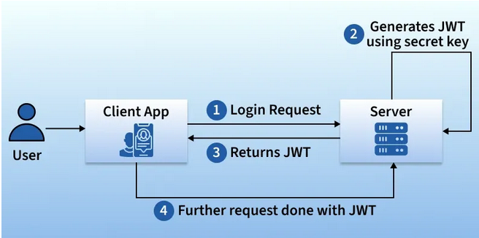
How JWT token Works?

Slide 15
JWE (JSON Web Encryption)?
JWE is a type of JWT where the payload is encrypted, ensuring confidentiality in addition to integrity.
The entire payload is encrypted using a public key or shared secret.
Only the intended recipient can decrypt and read the token contents.
Less common than JWS, but ideal for sensitive data transmission.
Use Case: Protecting personal or confidential information during transit.

Slide 16
JWT vs JWS vs JWE – Comparison Table
Feature | JWT (General) | JWS (Signed JWT) | JWE (Encrypted JWT)
Security Focus | Token Format | Integrity, authenticity | Confidentiality + integrity
Payload | Not specified | Base64URL encoded (readable) | Encrypted (not readable)
Signature | Optional | Required | Encrypted along with payload
Encryption | Optional | Not encrypted | Fully encrypted
Use Case | ID and Access Tokens | OAuth 2.0, OpenID Connect | Highly sensitive information

Slide 17
Structure of a JWT
A JWT consists of three parts, separated by dots (.):
xxxxx.yyyyy.zzzzz
Header — contains metadata about the token Example:
{
"alg": "HS256",
"typ": "JWT“
}
alg → signing algorithm (e.g., HS256)
typ → token type (JWT)

Slide 18
2. Payload — contains claims (information) about the user Example:
{
"sub": "1234567890",
"email": "user@example.com",
"iat": 1718888888,
"exp": 1718892488
}
sub → subject (usually user ID)
iat → issued at
exp → expiration time

Slide 19
3. Signature — used to verify that the token hasn’t been changed Example process:
HMACSHA256(
base64UrlEncode(header) + "." + base64UrlEncode(payload),
secret
)

Slide 20
JWT Signing Algorithms Explained
JWTs rely on signing algorithms to ensure tokens are valid and untampered. These algorithms play a critical role in verifying identity, especially in authentication and authorization workflows.
There are two core types of signing mechanisms used in JWTs: symmetric and asymmetric algorithms.

Slide 21
JWT Algorithm Types: Symmetric vs. Asymmetric
Understanding JWT algorithm types helps you choose the right method for your security needs.
1. Symmetric Algorithms (HMAC - HS256)
Symmetric algorithms like HS256 use the same secret key for both signing and verifying a token.
Easy to implement
Risky in distributed systems because the key must be shared between parties
const jwt = require('jsonwebtoken');
const token = jwt.sign({ userId: '12345' }, 'your-256-bit-secret', { algorithm: 'HS256' });

Slide 22
2. Asymmetric Algorithms (RSA, ECDSA)
Asymmetric algorithms such as RS256, ES256, and PS256 use a private–public key pair.
More secure for public APIs and microservices
The private key signs the token, while the public key verifies it and can be safely shared
const fs = require('fs');
const privateKey = fs.readFileSync('./private.key');
const token = jwt.sign({ userId: '12345' }, privateKey, { algorithm: 'RS256' });

Slide 23
JWT Algorithm List and Use Cases
Here’s a JWT algorithm list that highlights key algorithms used in production, with a quick comparison to help you decide:
Algorithm | Type | Key Used | Strengths
HS256 | Symmetric | Shared secret | Fast, simple to implement
RS256 | Asymmetric | RSA key pair | Secure for third-party verification
ES256 | Asymmetric | EC key pair | Lightweight, efficient
PS256 | Asymmetric | RSA-PSS | High-level cryptographic strength

Slide 24
How to Choose the Right JWT Algorithm
Use HS256 for small, internal apps where all services can securely share a secret key.
Use RS256 or ES256 for apps with external integrations, public APIs, or microservices, where stronger verification and key separation are needed.
Choose PS256 when compliance and modern cryptographic standards (like FIPS or GDPR) are essential.

Slide 25
Implementation of JWT using LoginRadius APIs
To implement JWT with LoginRadius:
Step 1: Configure a JWT App
Set up a JWT app in your LoginRadius Admin Console. Follow the JWT Admin Console Configuration guide.

Slide 26
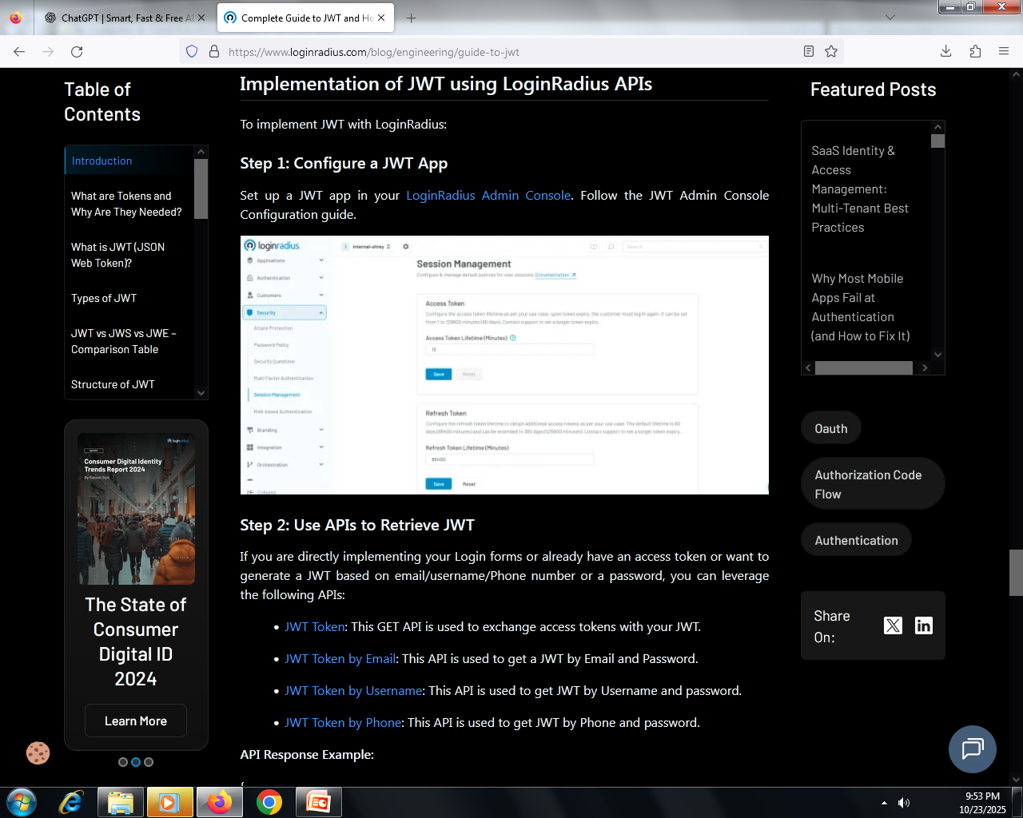

Slide 27
Step 2: Use APIs to Retrieve JWT
If you are directly implementing your Login forms or already have an access token or want to generate a JWT based on email/username/Phone number or a password, you can leverage the following APIs:
JWT Token: This GET API is used to exchange access tokens with your JWT.
JWT Token by Email: This API is used to get a JWT by Email and Password.
JWT Token by Username: This API is used to get JWT by Username and password.
JWT Token by Phone: This API is used to get JWT by Phone and password.
API Response Example:
{
"signature": "<JWTresponse>"
}
These tokens can then be used in your client app for authenticated requests.

Slide 28
Best Practices for Secure JWT Authentication
To implement JWT securely, follow these key practices:
Keep Signing Keys Secure
Private keys or secrets used to sign JWTs must be stored securely.
Avoid Sensitive Data in Payload
Payload is only base64 encoded—not encrypted. Do not include passwords, PII, or credentials unless using encrypted JWT (JWE).
Limit Token Claims
Include only essential claims in the token to reduce size and exposure.
Use HTTPS
Always transmit JWTs over HTTPS to prevent man-in-the-middle attacks.
Set Short Expiry Times
Use short exp durations and implement refresh tokens to reduce impact if a token is compromised.
Implement Token Revocation
Use jti with a blacklist or maintain a revocation strategy for enhanced control.

Slide 29
Why Are JWTs Important for Authentication and Security?
JWTs offer numerous benefits in authentication systems:
Stateless Authentication – No need to maintain session state on the server.
Scalability – Suitable for microservices and distributed systems.
Tamper Resistance – Digitally signed tokens ensure data integrity.
Performance – Reduces server load and database dependencies.
Cross-Platform Support – Easily used across web, mobile, and API ecosystems.
Enhanced Security – Signed tokens ensure authenticity and tamper-proof data.
Developer Convenience – Simplifies session management.
JWTs are widely adopted in OAuth 2.0, OpenID Connect, and API security implementations.

